Slide 1

FRACTIONAL CFO · OUTSOURCED FINANCE · CROSS-BORDER TAX
CORPORATE PROFILE · 2026
Resurgent
Montreal
North American Governance.
Eastern Cost Advantage.
R
RESURGENT MONTREAL Corporate Profile 2026
Montreal + Dubai 01

Slide 2
WHO WE ARE
A Canadian finance firm, built for a borderless world
Resurgent Montreal is a Canadian business advisory and outsourced finance firm delivering Fractional CFO services, accounting & bookkeeping, taxation, financial reporting and cross-border structuring to public-listed and private companies worldwide.
Incorporated in Canada in 2018 and headquartered in Montreal, we now run a globally integrated delivery platform — with back-office hubs across Canada, India, Bangladesh and New Zealand, and a growing base in Dubai, UAE — powering a true 24/7 model.
2018
Incorporated in Canada
6
Countries in the delivery network
24/7
Follow-the-sun turnaround
2
Continental hubs — Montreal & Dubai
R
RESURGENT MONTREAL Corporate Profile 2026
Montreal + Dubai 02

Slide 3


THE RESURGENT PROPOSITION
Two strengths. One integrated firm.
NORTH AMERICAN
GOVERNANCE
EASTERN
COST ADVANTAGE
CPA-led, Canadian professional standards
Global delivery hubs in India, Bangladesh & NZ
+
TSX-V / CSE public-company reporting & MD&A
40–60% lower cost than in-house finance teams
Audit-ready files and clean auditor hand-off
24/7 follow-the-sun — zero backlog
Robust internal controls & board-grade rigor
Scale the team up or down, on demand
Direct, accountable client relationship
Dubai hub for tax-efficient cross-border reach
R
RESURGENT MONTREAL Corporate Profile 2026
Montreal + Dubai 03

Slide 4
GLOBAL DELIVERY MODEL
One firm, six time zones, 24/7
Work moves with the sun. A file opened in Montreal is progressed overnight across our Asian hubs and returned before the next business day — with Dubai bridging East and West.
MONTREAL
North American HQ
DUBAI
Cross-Border Hub
Governance · CPA standards · public-company reporting · client relationship
North American client support · bookkeeping · UAE tax & structuring
DELIVERY & BACK-OFFICE NETWORK
Canada
India
Bangladesh
New Zealand
UAE
Reporting & review
Accounting & tax
Bookkeeping & ops
Overnight coverage
North American support & bookkeeping
Clients served across Canada · USA · Mexico · UK · Ireland · Austria · Middle East · India
R
RESURGENT MONTREAL Corporate Profile 2026
Montreal + Dubai 04

Slide 5
OUR SERVICES
A full finance function, on demand
Fractional CFO
Controller
Bookkeeping
Due Diligence
Advisory & Tax
Stock-exchange reporting & MD&A
Full-cycle accounting
Up-to-date, zero backlog
Buy-side financial DD
Cross-border tax structuring
Financing & financial modelling
GST / PST / VAT returns
24/7 follow-up service
Valuation reports
Investor presentations & IM
Reverse takeovers / RTOs
Audit coordination
QuickBooks, Sage, Xero,
Financial modelling
Transfer pricing
Internal controls & ERP
Month-end & close
Acomba, SAP experts
Quality of earnings
M&A structuring
R
RESURGENT MONTREAL Corporate Profile 2026
Montreal + Dubai 05

Slide 6
NEW — DUBAI DESK
Two countries,
one set of books
UAE Bookkeeping & Accounting
For clients with companies in both Canada and Dubai — one firm keeps both sets of books, reconciled and reporting-ready
Many of our clients run companies in both Canada and the UAE. Resurgent keeps both sets of books — reconciled, compliant and reporting-ready — under one firm, one point of contact.
UAE–India · UAE–USA · UAE–Canada
bookkeeping, tax & structuring across both jurisdictions
Cross-Border Tax & Structuring
UAE–India / UAE–USA / UAE–Canada personal & corporate tax, tax-efficient and compliant
UAE Corporate Tax & VAT
Registration, compliance and ongoing filing under the new UAE regime
Company Setup & Back-Office
Free-zone / mainland setup with bookkeeping and CFO support built in
R
RESURGENT MONTREAL Corporate Profile 2026
Montreal + Dubai 06

Slide 7
SECTORS SERVED
Depth across regulated, capital-intensive industries
Mining & Resources
Telecom
Real Estate
Juniors, RTOs, exploration & DSO projects
Controller & reporting for network operators
Structuring, reporting and financing support
Pharma & Health
Trading & Distribution
Public Capital Markets
Compliance-heavy reporting and controls
Multi-currency accounting and margins
TSX-V / CSE listed issuer reporting
R
RESURGENT MONTREAL Corporate Profile 2026
Montreal + Dubai 07

Slide 8
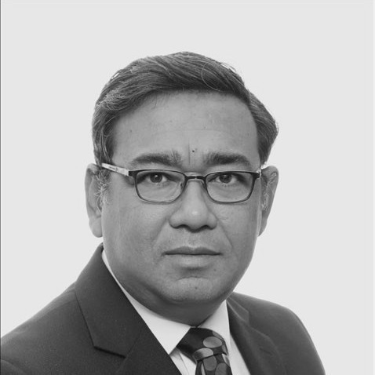
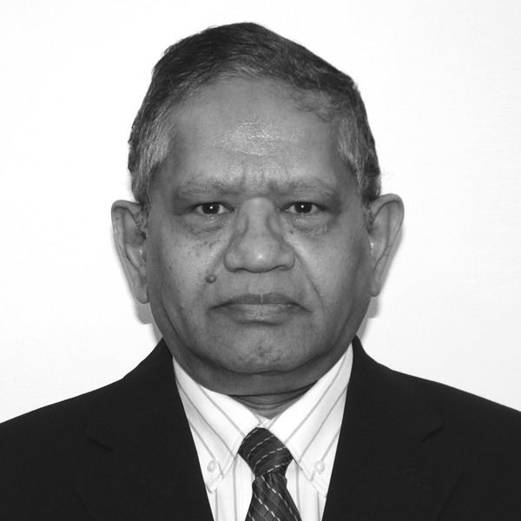
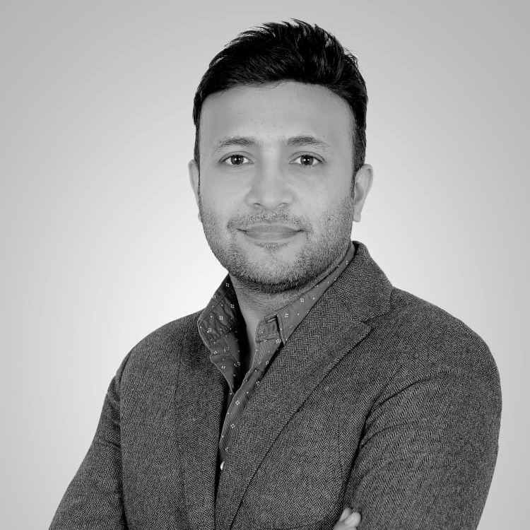
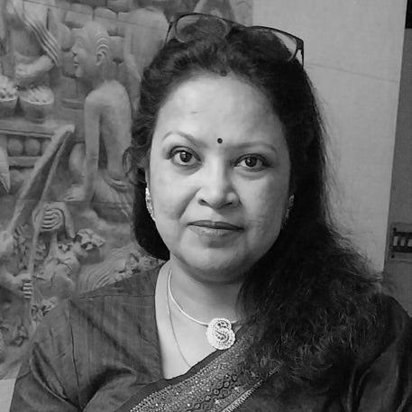


OUR TEAM
One team, four countries — governance where it counts
CANADA
UNITED STATES
UNITED ARAB EMIRATES
INDIA
Arnab De
Krish Ramakrishnan
Piyush Jain
Rima Roychowdhury
Founder & Managing Director
US Desk Lead
UAE Desk Lead
India Desk Lead
Tata-groomed, 19+ yrs in the Tata Group. Ex-CFO, Tata Steel Minerals Canada — DSO project & $1.5B+ funding. Fractional CFO to listed issuers.
Leads US client engagements — full-cycle accounting, bookkeeping and management reporting for North American companies.
Ex-FedEx, Kellogg's, Mondelez & Ball. Led finance teams of 80+ across Europe, MEA & India for $1B+ businesses.
Ex-EY International Tax Head. Cross-border tax for corporates & HNW individuals; controllership & assurance.
CPA · CGMA · CMA · MBA (IIMC)
CPA · CA
CA · 25+ yrs
CA · Ex-EY
arnabde@resurgentmontreal.ca
krish@resurgentmontreal.ca
piyush.jain@resurgentmontreal.ca
rima@resurgentmontreal.ca
in in/arnab-de-08191a95
R
RESURGENT MONTREAL Corporate Profile 2026
Montreal + Dubai 08

Slide 9
SELECTED CLIENTS
Trusted by listed issuers and founders alike
Fancamp Exploration
Silver Acadia Resources
Defence Therapeutics
TSX-V : FNC
CSE : SLA
CSE : DTC
EDM Resources
Telus
Goldera
TSX-V : EDM
TSX : T
NYSE : TU
PRIVATE
Analog Gold
Eleu Health
Camelion North America
PRIVATE
PRIVATE
PRIVATE
Engagements span public-company CFO mandates, cross-border tax and full outsourced finance. Tickers shown for listed issuers; private companies marked accordingly.
R
RESURGENT MONTREAL Corporate Profile 2026
Montreal + Dubai 09

Slide 10
WHY RESURGENT
Governance you can bank on — at a cost that scales
01 Credible track record
02 One-stop finance function
03 International tax expertise
A Tata grooming — board-grade discipline delivered to every engagement.
Finance, accounts, corporate tax, VAT, transfer pricing and advisory under one roof.
Cross-border structuring across UAE, India, USA and Canada.
04 Local presence, global reach
05 24/7 responsiveness
06 Right-sized economics
On-the-ground in Montreal and Dubai; delivery across four continents.
Response centres spread across the world — no backlog, fast turnaround.
Eastern delivery cost with North American quality and accountability.
R
RESURGENT MONTREAL Corporate Profile 2026
Montreal + Dubai 10

Slide 11
THE RESURGENT AI JOURNEY
From bookkeeping to an AI-native finance firm
We build our own tools. AI amplifies the follow-the-sun model — more throughput, fewer errors, lower cost, with governance intact.
01
02
03
04
DIGITIZE
AUTOMATE
AGENTIC
INSIGHT
Cloud accounting on QuickBooks / Xero — paperless, real-time books across every entity.
QBO-integrated AP portals: invoice → approval → payment, with automated bank matching.
A proprietary AI CFO Suite — agents for cap tables, IAS 24 related-party, FS compilation & vendor ledgers.
Live corporate dashboards publishing FS, MD&A, AP and market data — board-grade insight on demand.
BUILT IN-HOUSE, DEPLOYED FOR CLIENTS
AP Payment Portal — live
AI CFO Suite
Corporate Intranets
Document AI · OCR
Mail Assistant
R
RESURGENT MONTREAL Corporate Profile 2026
Montreal + Dubai 11

Slide 12

LET'S TALK
North American Governance.
Eastern Cost Advantage.
A finance partner that reports like a North American CFO and scales like a global delivery centre.
Resurgent Montreal Inc. — Montreal — 1216-3577 Ave Atwater, Montreal, QC H3H 2R2
Resurgent Montreal FZCO — Dubai — United Arab Emirates · +971 58 619 2400
Web — resurgentmontreal.ca
LinkedIn — linkedin.com/in/arnab-de-08191a95
Scan to visit
resurgentmontreal.ca
Contact — Arnab De, CPA · arnabde@resurgentmontreal.ca
Resurgent Montreal™ is a trademark of Resurgent Montreal Inc. (Canada) and Resurgent Montreal FZCO (UAE).
R
RESURGENT MONTREAL Corporate Profile 2026
Montreal + Dubai 12

